Slide 1
Tools for Agile Development
Day 4

Slide 2
Outlines
Postman
Slack
Trello
Jenkins

Slide 3

Postman
Download: https://www.getpostman.com/
Notes:
แนะนำตัวโปรแกรม ฟีเจอร์ ละเปรียบเทียบ
เวอร์ชั่น Free vs Pro
https://www.getpostman.com/pricing

Slide 4
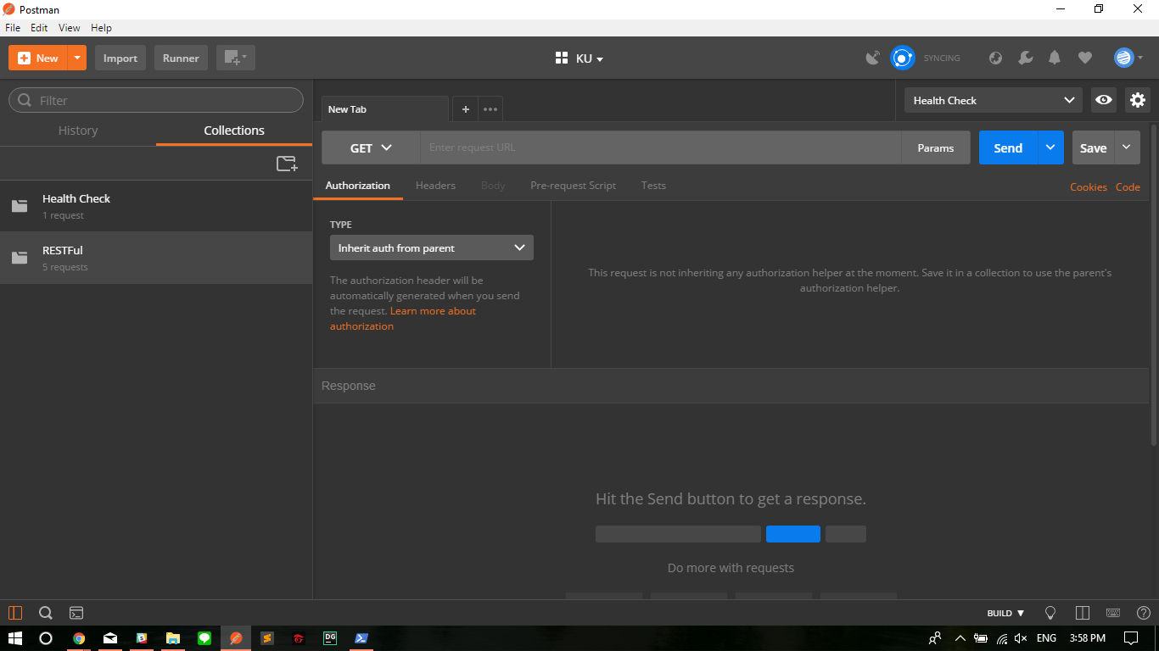

Slide 5
Postman
Create New Workspace
Manage Environment
Create Collection
Create Request
Export and Share Collection
Publish API Document
Write Tests
Mock Request

Slide 6
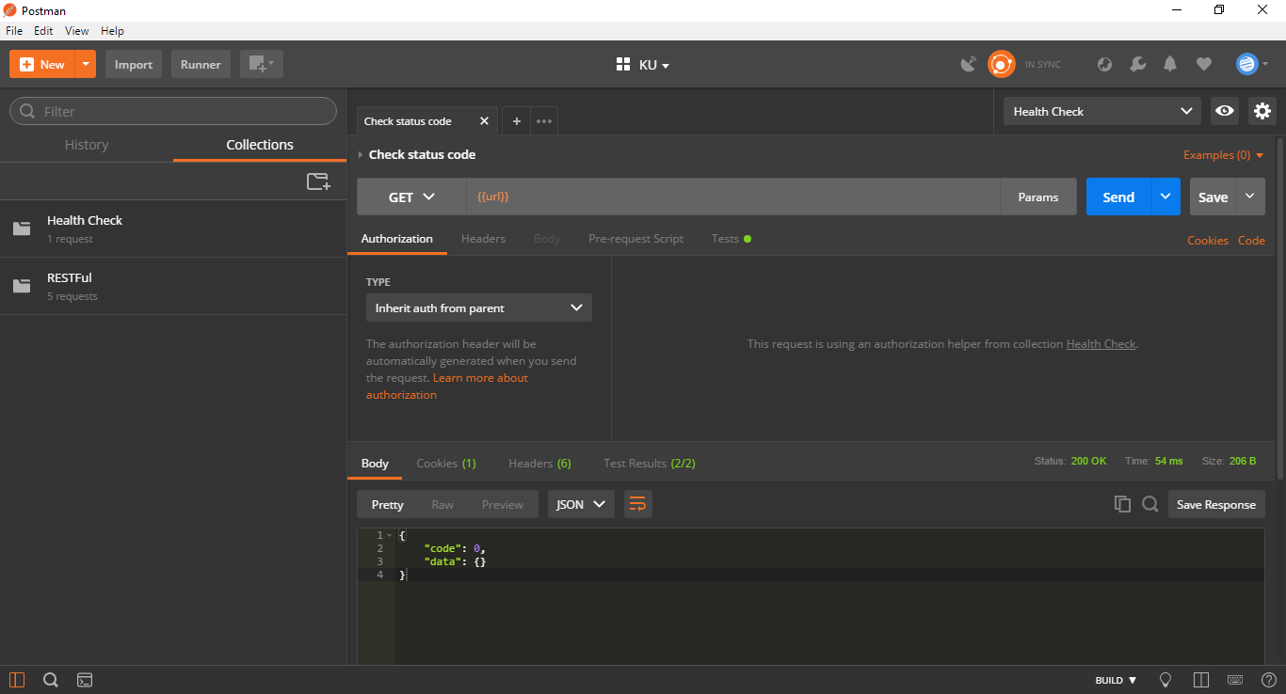
Postman

Slide 7
Postman
Create New Workspace
Manage Environment
Create Collection
Create Request
Export and Share Collection
Publish API Document
Write Tests
Mock Request

Slide 8
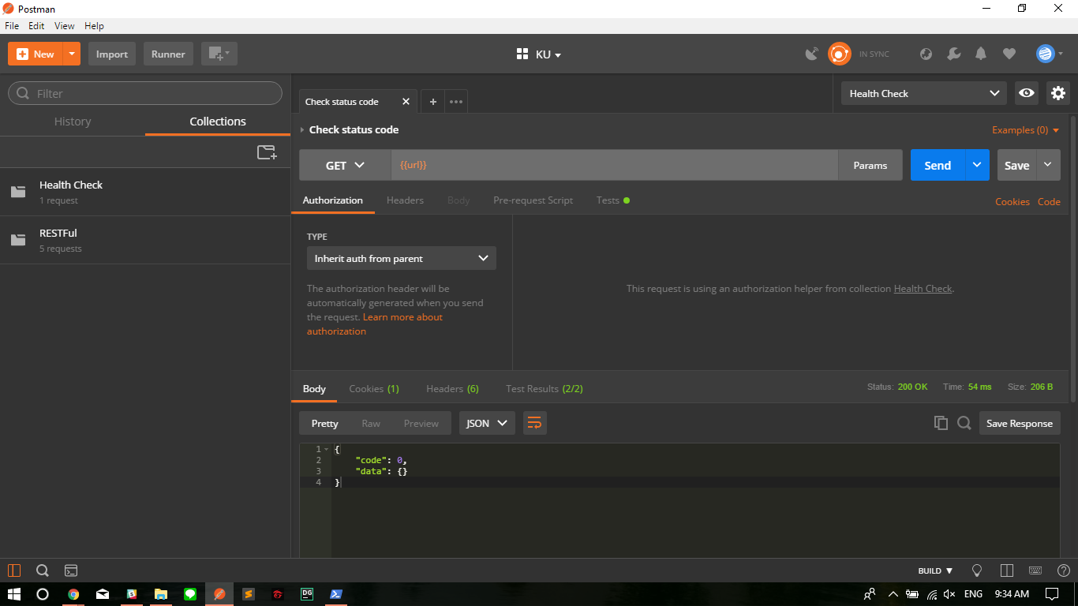

Slide 9
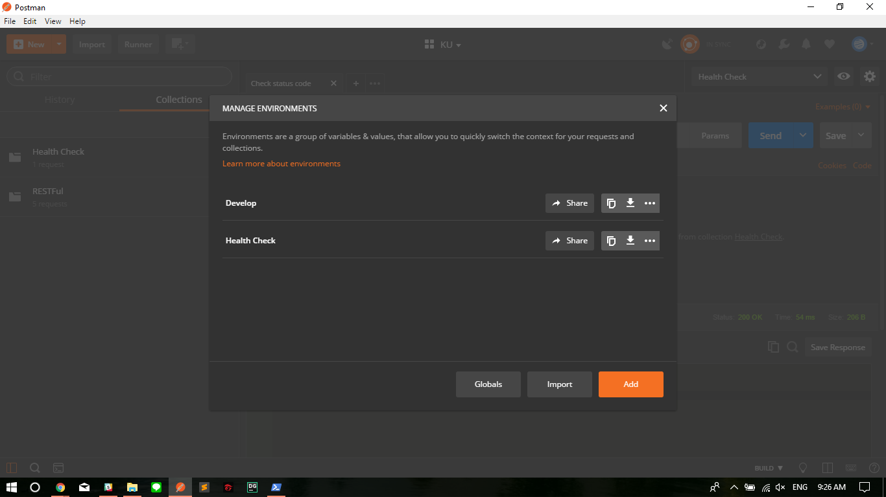
Postman

Slide 10
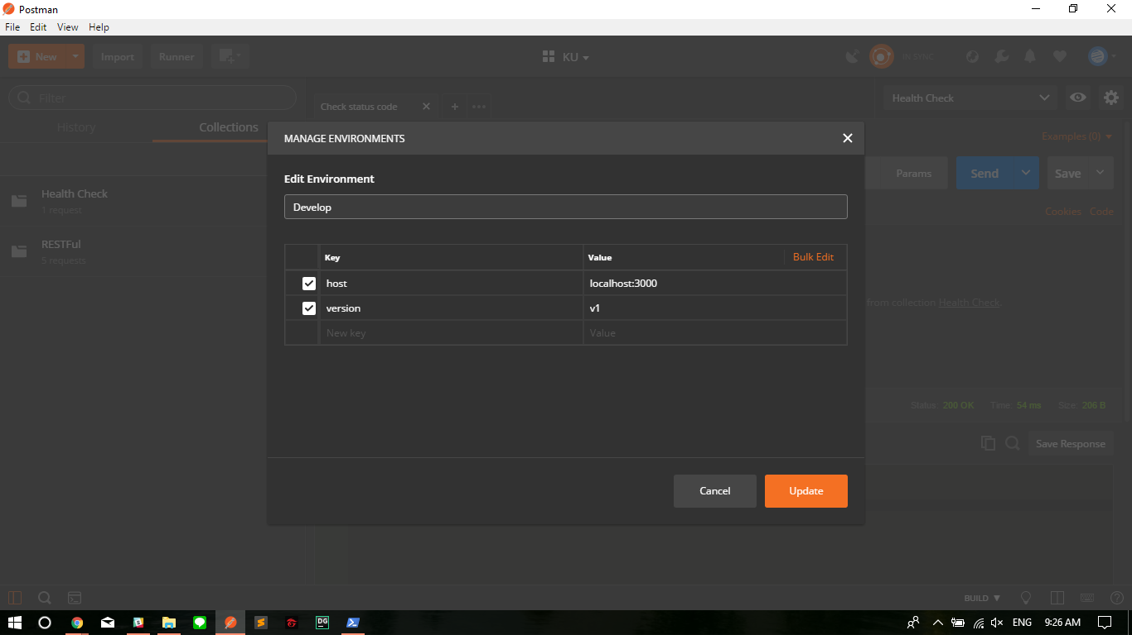
Postman

Slide 11
Postman
Create New Workspace
Manage Environment
Create Collection
Create Request
Export and Share Collection
Publish API Document
Write Tests
Mock Request

Slide 12
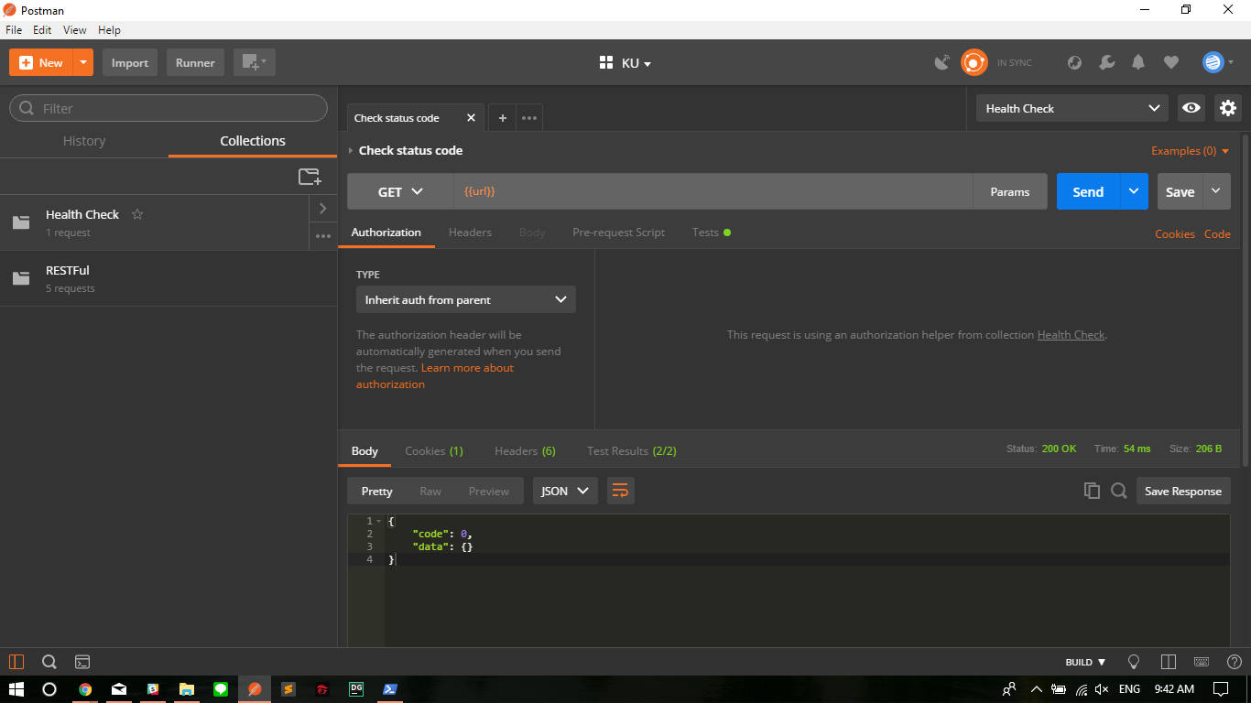
Notes:
พยายาม ให้ใส่ Description ให้ครบ

Slide 13
Postman
Create New Workspace
Manage Environment
Create Collection
Create Request
Export and Share Collection
Publish API Document
Write Tests
Mock Request

Slide 14
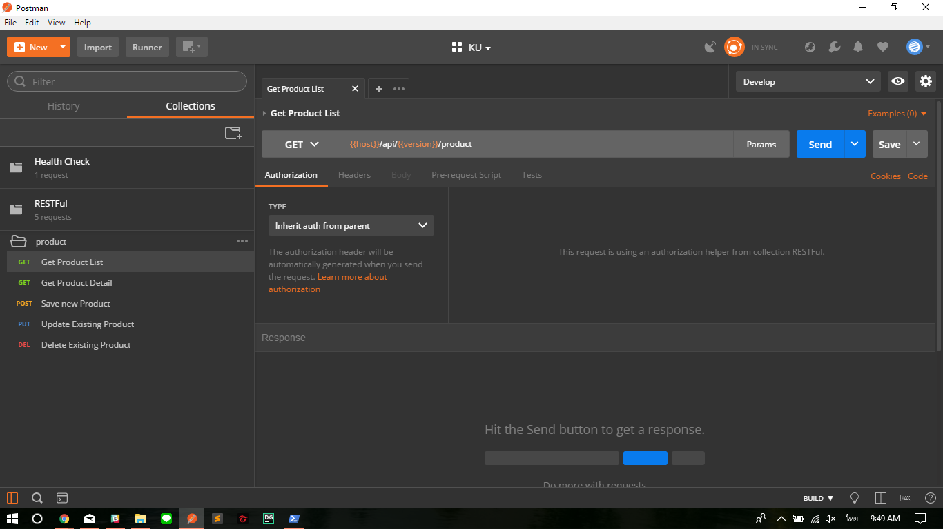

Slide 15
Postman
Create New Workspace
Manage Environment
Create Collection
Create Request
Export and Share Collection
Publish API Document
Write Tests
Mock Request

Slide 16
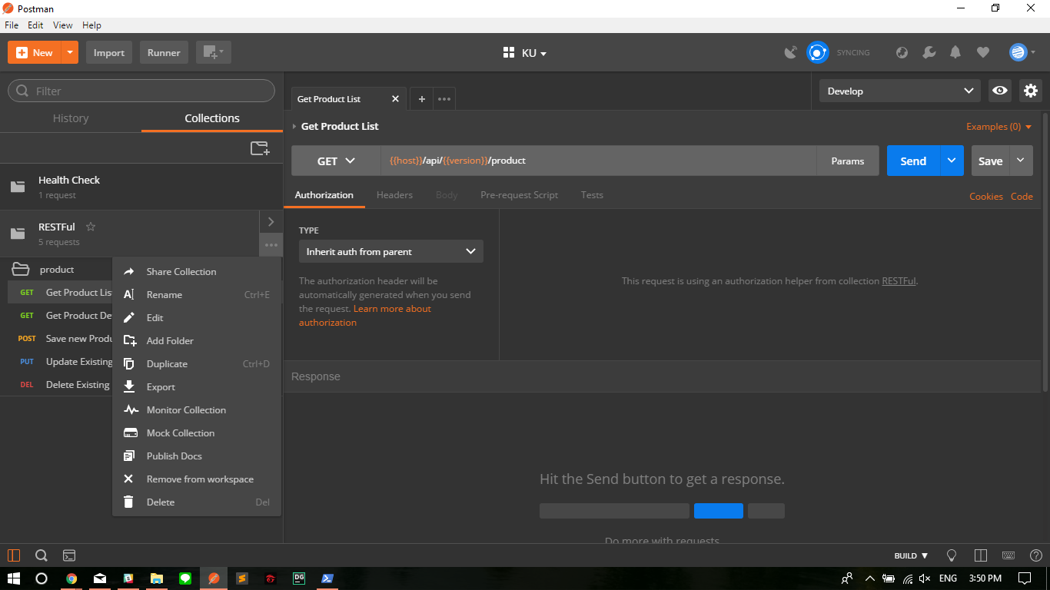

Slide 17
Postman
Create New Workspace
Manage Environment
Create Collection
Create Request
Export and Share Collection
Publish API Document
Write Tests
Mock Request

Slide 19
Postman
Create New Workspace
Manage Environment
Create Collection
Create Request
Export and Share Collection
Publish API Document
Write Tests
Mock Request

Slide 20
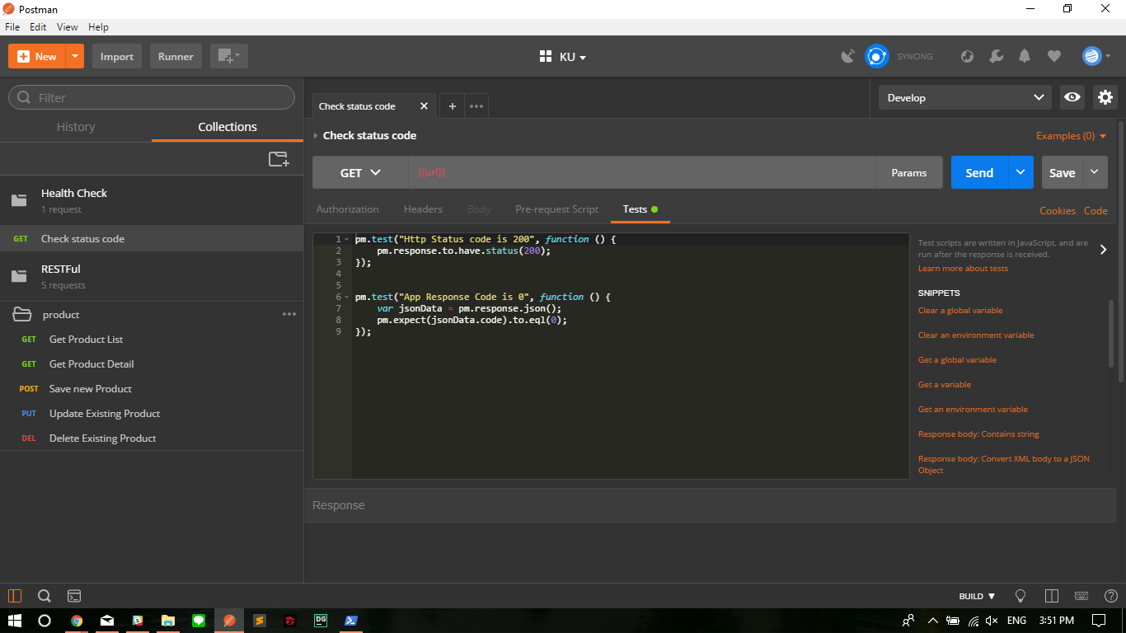

Slide 21
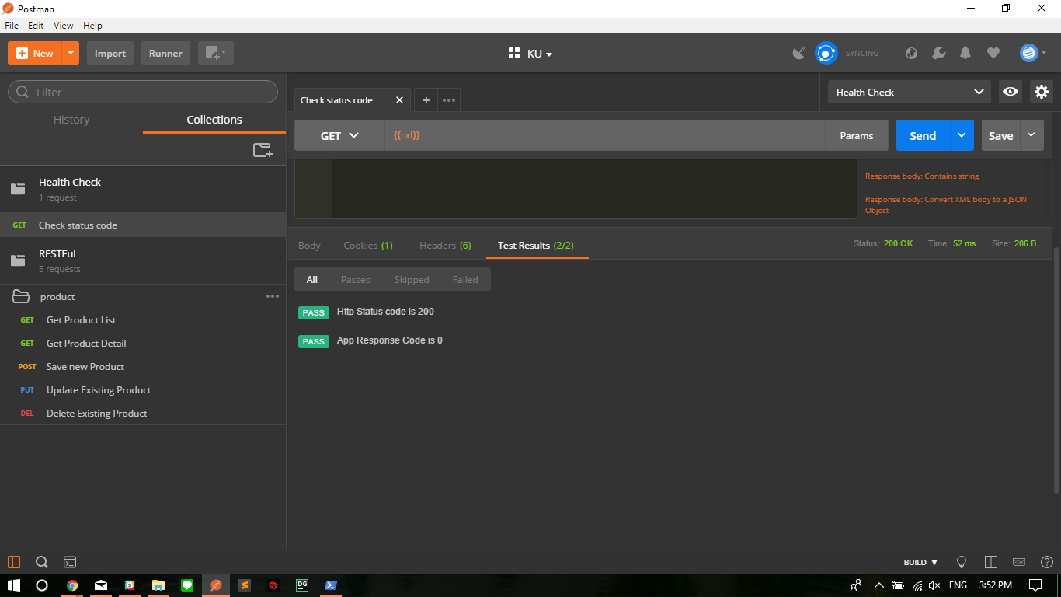

Slide 22
Postman
Create New Workspace
Manage Environment
Create Collection
Create Request
Export and Share Collection
Publish API Document
Write Tests
Mock Request

Slide 23
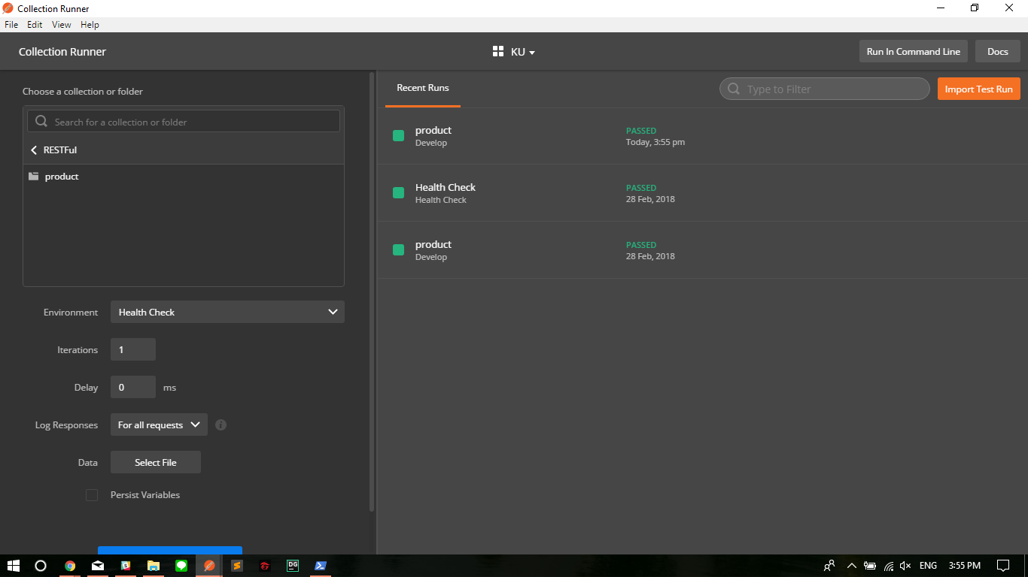
Notes:
Runner Menu
ลงไม่ค่อยลึก บอกแค่ว่ามันทำได้ แต่ติดเพราะยังไม่อัพเกรดให้กลายเปน Pro Version

Slide 24
Postman
Pre-Requisite
git clone https://github.com/csithdev/ku_backend.git
npm install nodemon -g
Go into /ku_backend
npm install
npm start

Slide 25
Postman
Install Mongodb in your Docker
Start Docker
docker run -p 27017:27017 --name mongo_serv -d mongo
docker exec -it mongo_serv mongo
use ku_teaching

Slide 26
Postman
Lab 01
Create Dev / Sys / Prod Environment
Create RESTful “Product” Collection with Requests
Write Tests
Commit to Git Repo : day2_git_assignment

Slide 27
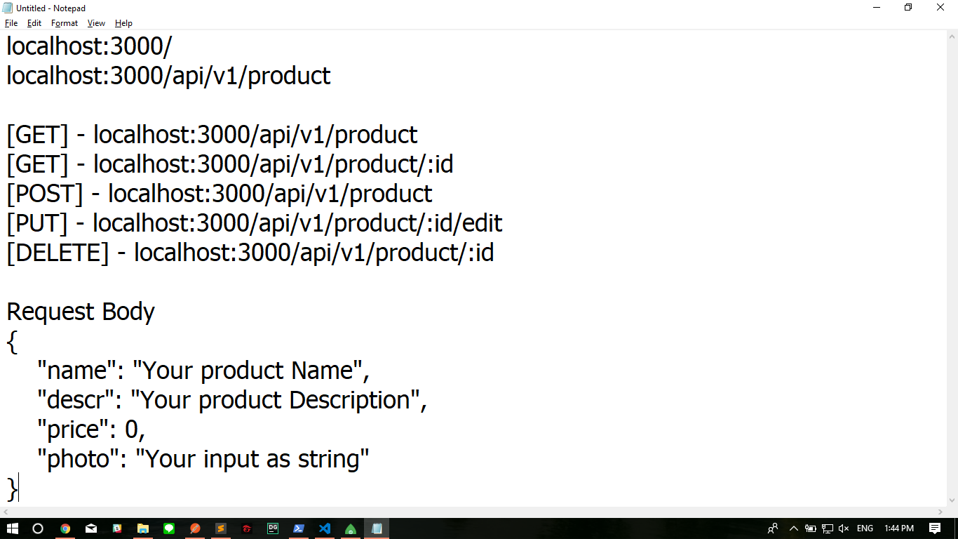

Slide 28
Slack
Features
Team Instant Messaging
Cross-Platform support
Plenty of APIs
Many Integration available
Slack Bot :)
Notes:
https://slack.com/features

Slide 29
Slack
1. Create or Join Workspace

Slide 30
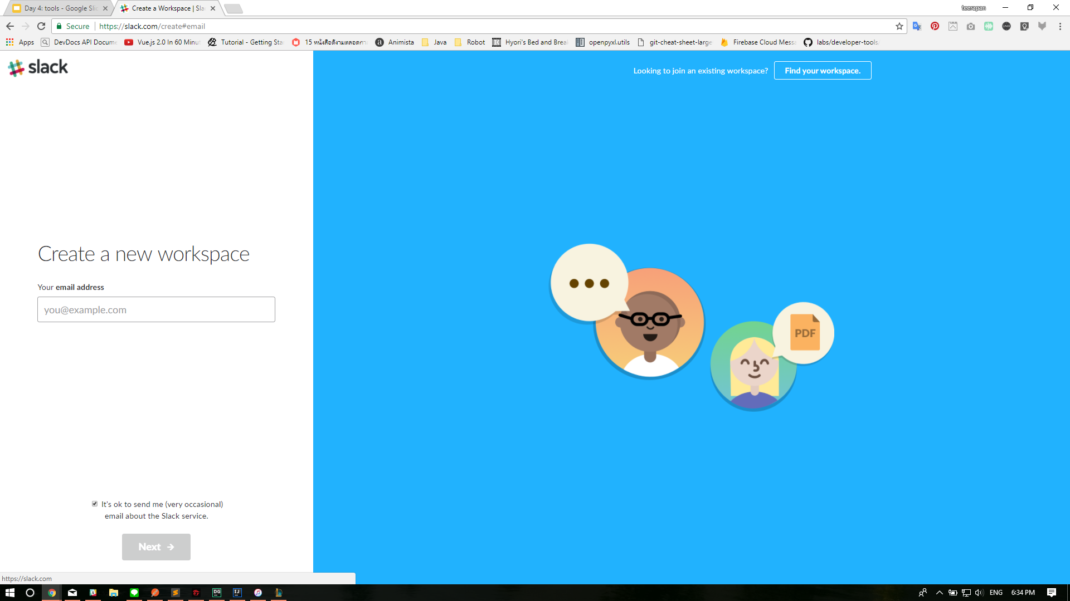

Slide 31
Slack
2. Invite all the people

Slide 32
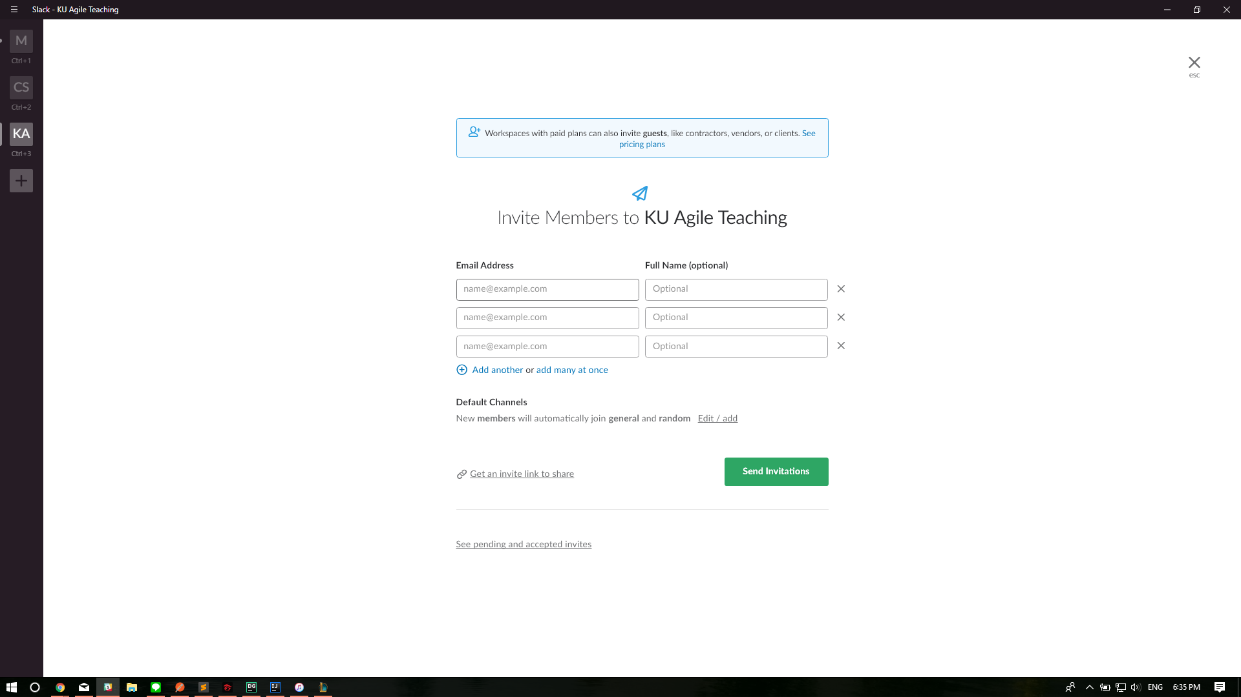

Slide 33
Slack
3. Start using Slack!

Slide 34
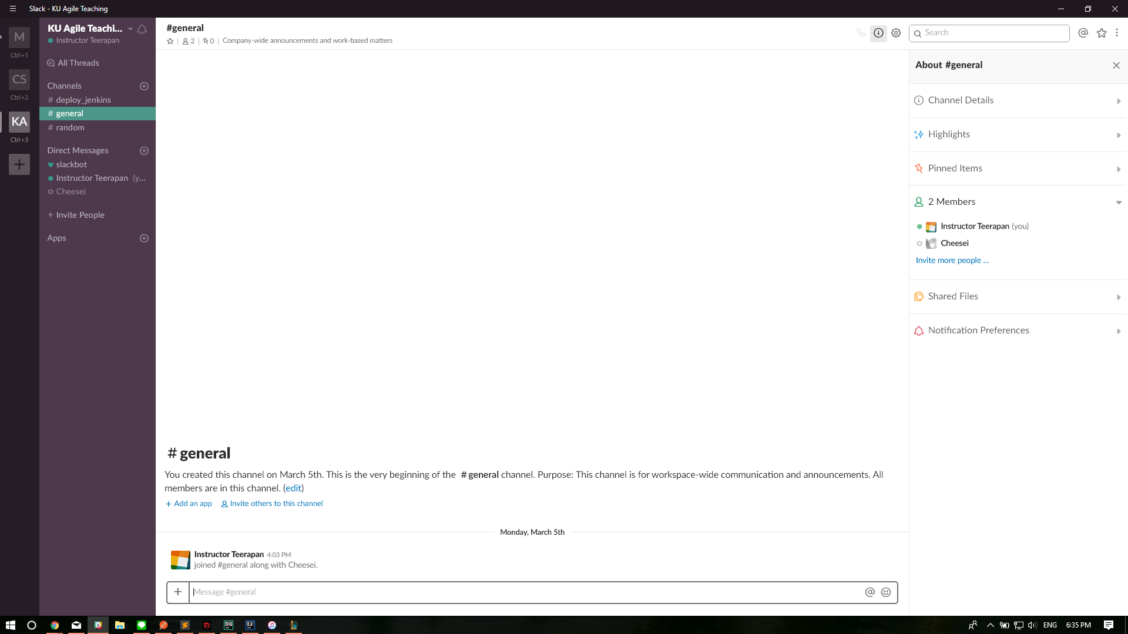

Slide 35
Slack
More Setting
Setting & Permission
Customize your workspace
** Integrating Apps and Customizing it
You can even build your own apps! (Documentation: https://api.slack.com/)
Notes:
Sample
DailyMeeting
Simple Poll
Geekbot
Jenkins
Trello
Build Documentation
https://api.slack.com/

Slide 36
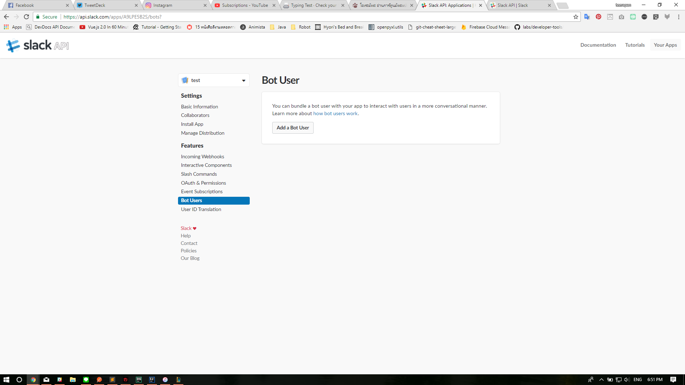
Notes:
https://api.slack.com/apps

Slide 37
Trello
https://trello.com

Slide 38
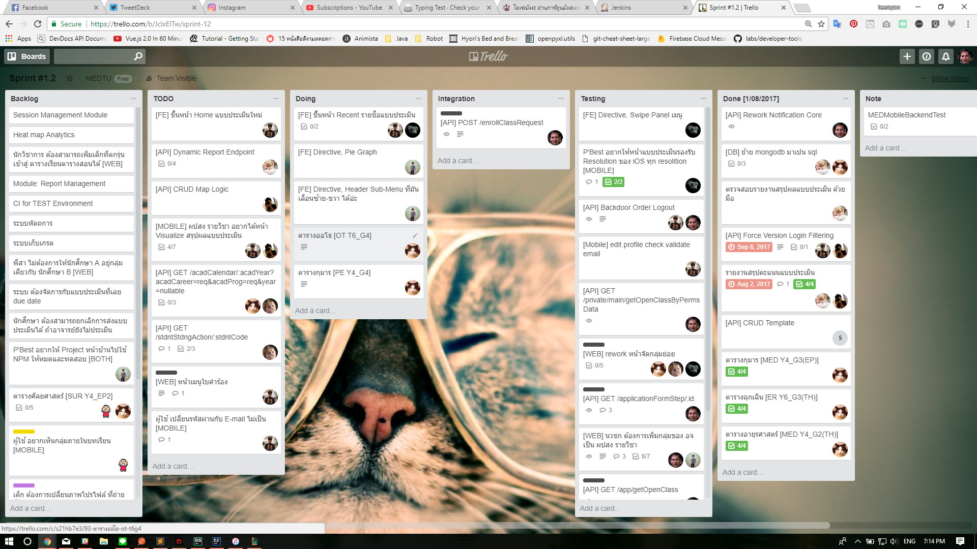

Slide 39
Jenkins
What is CI/CD?
What is Jenkins?
Why do we use it?

Slide 40
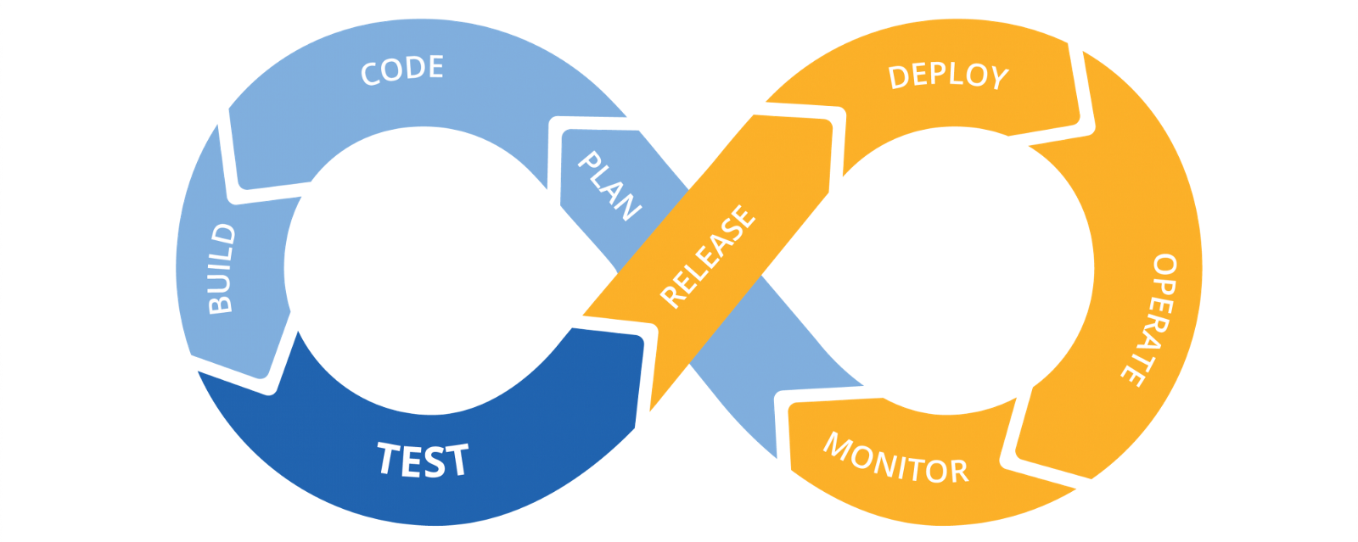
CI/CD

Slide 41
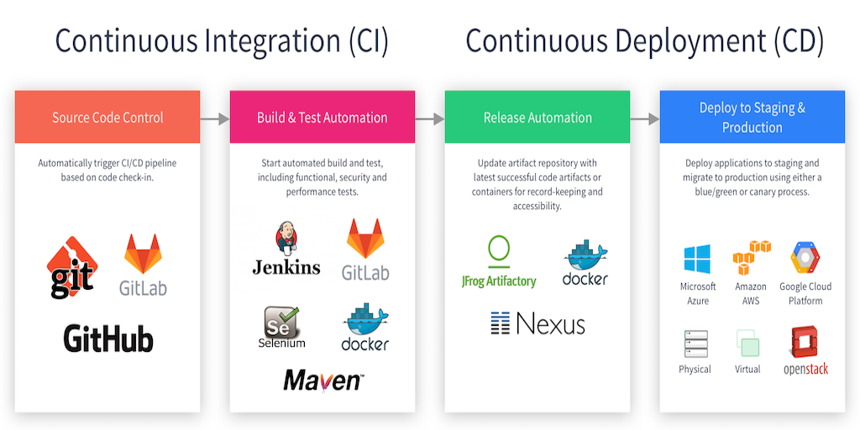
CI/CD

Slide 42
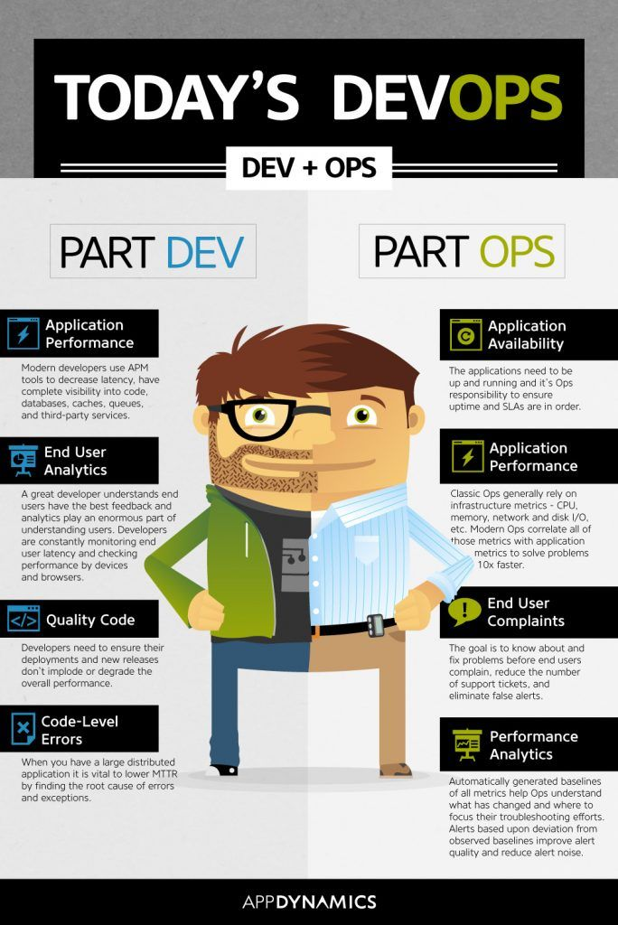

Slide 43
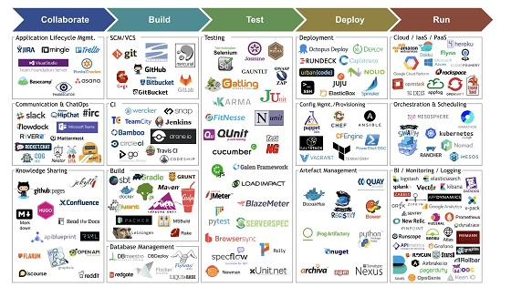
DevOps

Slide 44
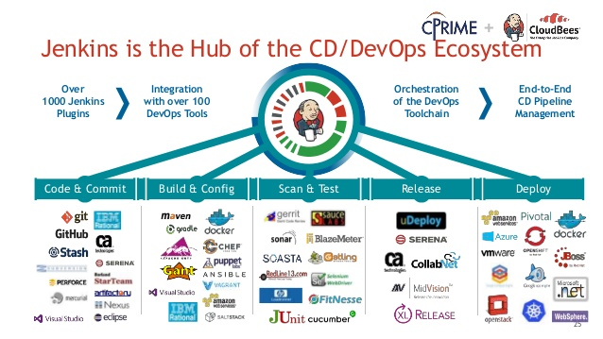
Jenkins
Notes:
The leading open source automation server, Jenkins provides hundreds of plugins to support building, deploying and automating any project.

Slide 45
Jenkins
Installation
Start your Docker
Pull jenkins images from , https://hub.docker.com/r/jenkins/jenkins/
Start your Container with jenkins images
Configure your Jenkins

Slide 46
Jenkins
Installaton
Start your Docker
docker pull jenkins/jenkins
docker run -p 8081:8080 --name docker_jenkins -d jenkins/jenkins
localhost:8081

